Slide 1

Applying Machine Learning Algorithms on F1 Dataset
Umaya Rahman Akhi

Slide 2

Introduction
To apply five different machine learning algorithms on F1 dataset
Relevant key columns: 'grid', 'position_x', 'laps', 'fastestLap', 'rank', 'circuitId', 'points_x’.
The target variable is ‘points_x’
Predicting ‘points_x’ can provide insights into driver performance, consistency, and competitiveness across different races and circuits

Slide 3
Mind map
Adjusted R-squared Score
TensorFlow
LinearRegression ()
Capstone Project
Seaborn
NumPy
DecisionTreeRegressor()
Scikit-learn
Keras
RandomForestRegressor()
Models
Tools
Conv1D
KNeighborsRegressor()
LSTM
Dense
CNN - LSTM
R-squared (R^2) Score, Mean Squared Error (MSE)
Pandas
Matplotlib

Slide 4

Input and Output Data
Input: ‘grid’, ‘position_x’, ‘laps’, ‘fastestLap’, ‘rank’, ‘circuitId’
Output: ‘points_x’

Slide 5
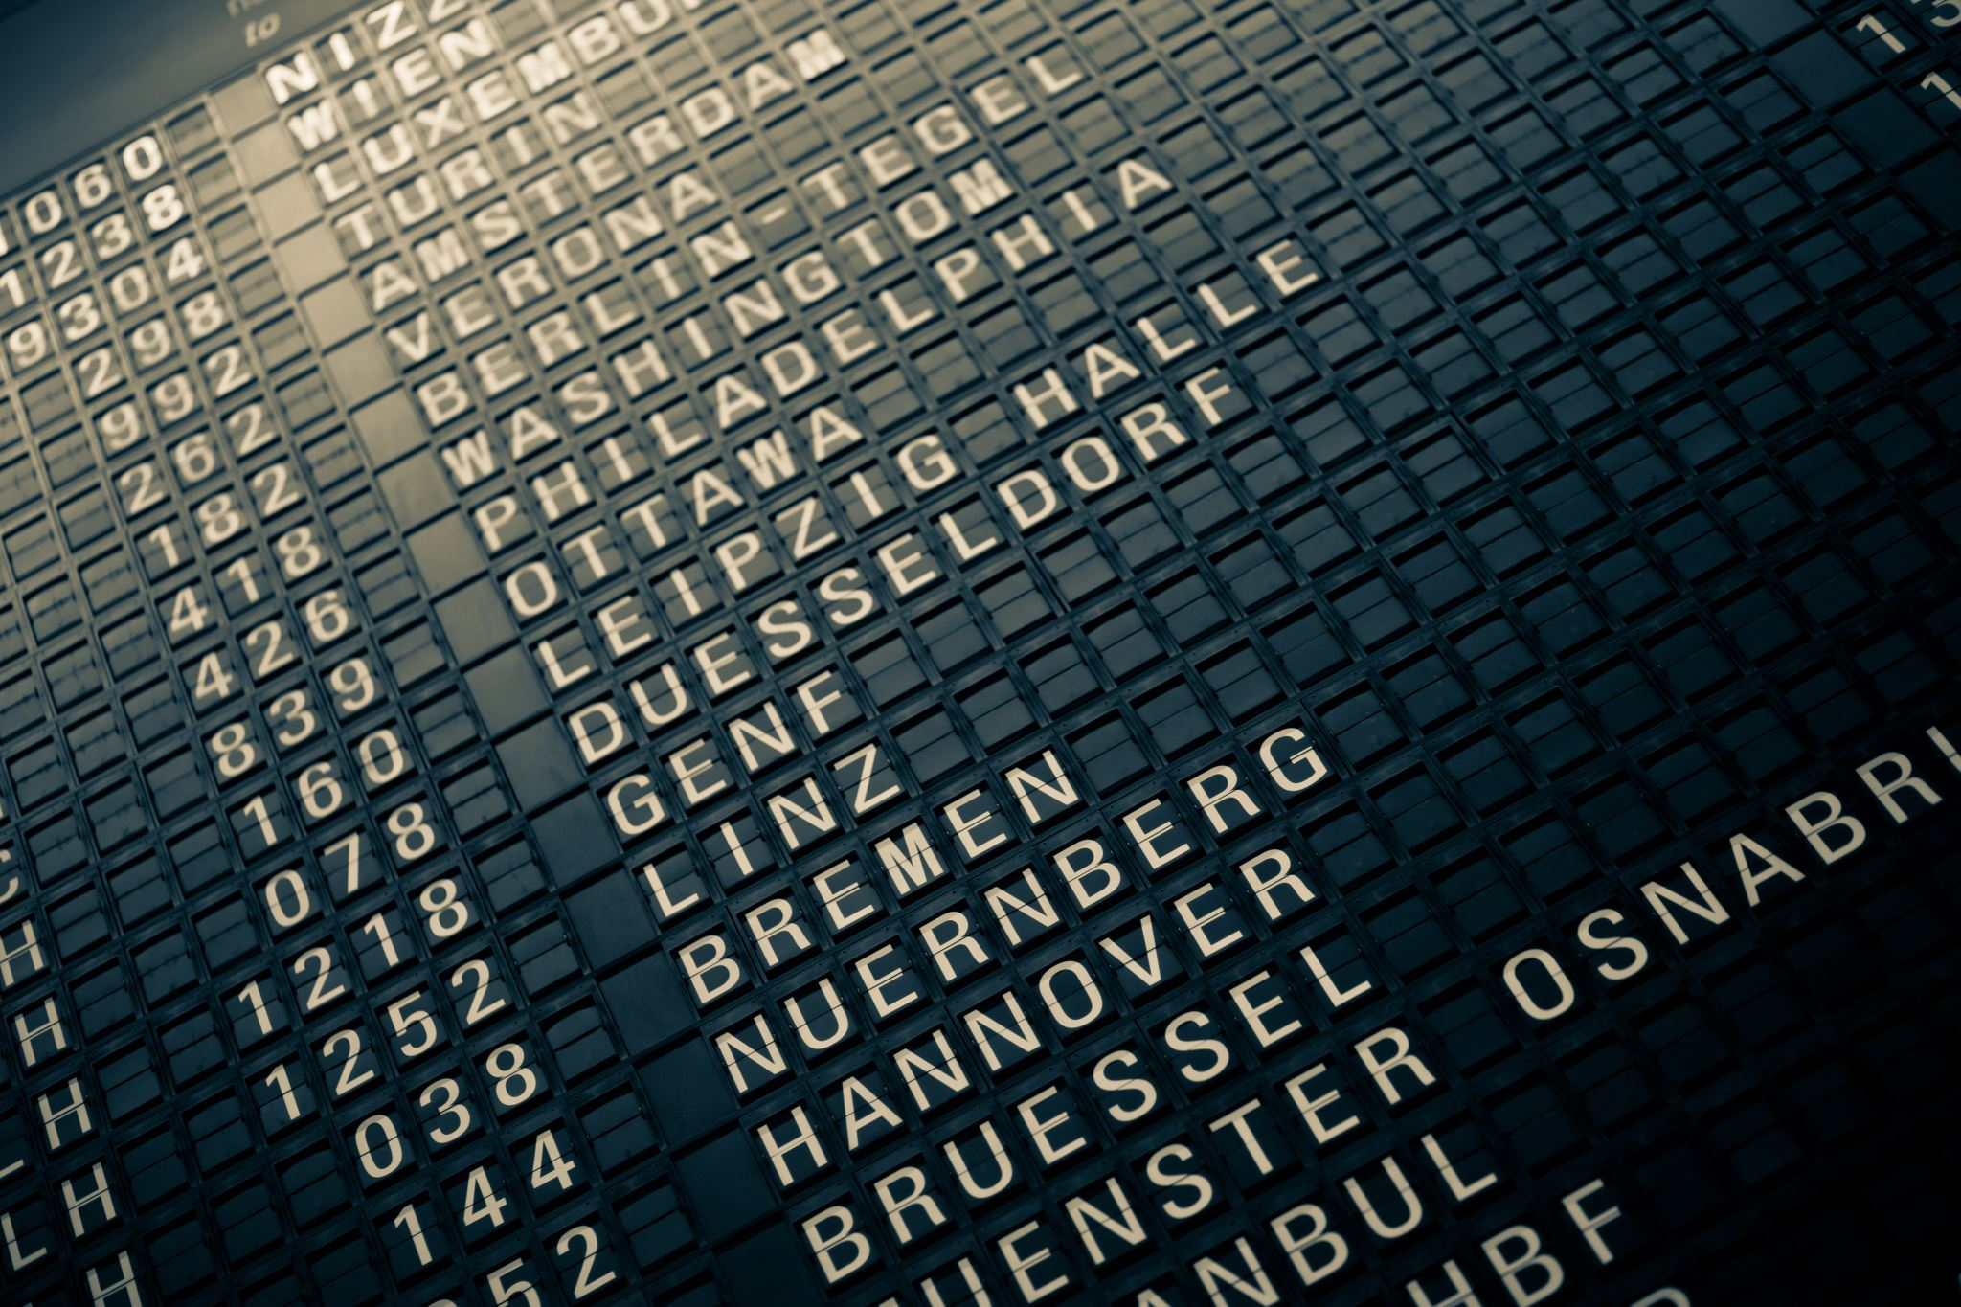
Data Pre-Processing
Feature selection
Handling missing values
Feature scaling
Train-test split

Slide 6
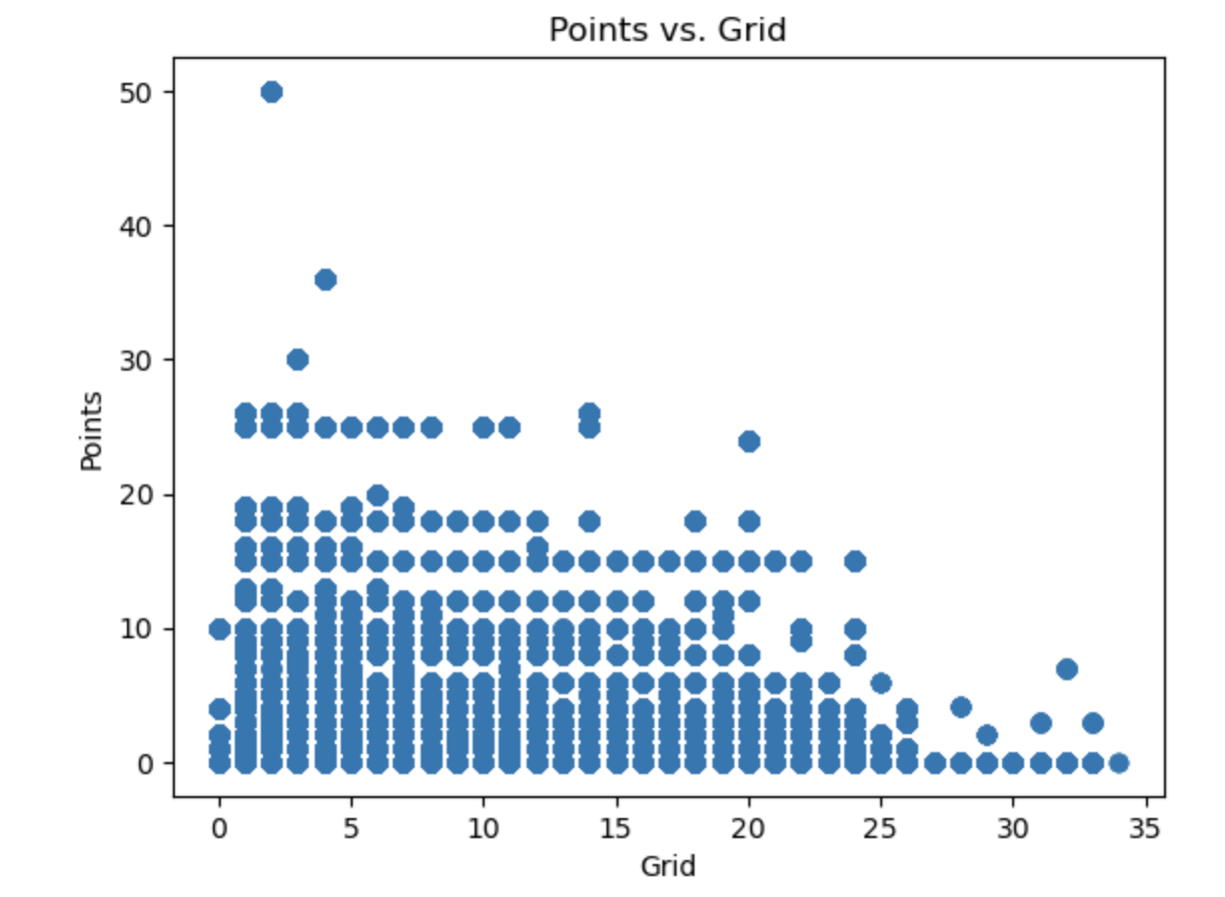
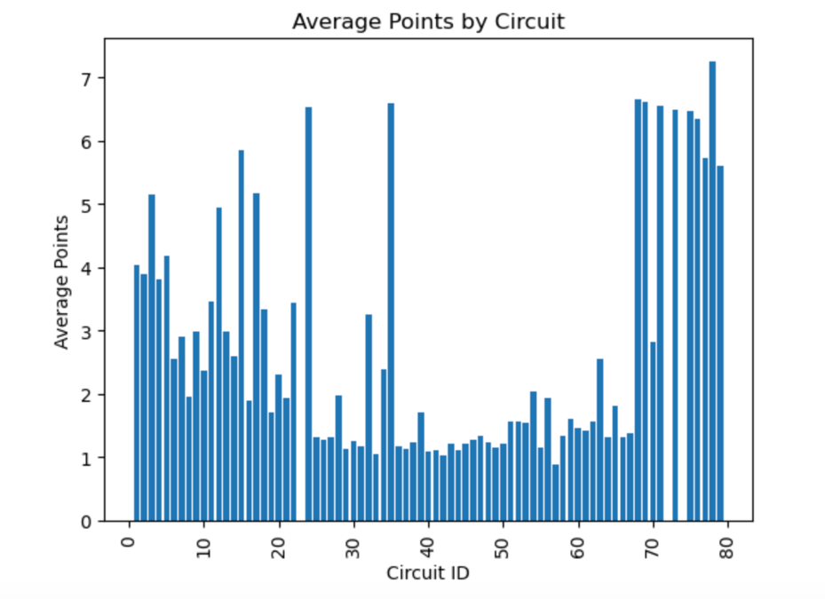
Exploratory Data Analysis
Scatter plot analysis of ‘grid’ and ‘points_x’ relationship
Average points by circuit analysis using bar plot

Slide 7
Model Training and Comparison
Model | MSE
Decision Tree Regressor | 0.0014
Random Forest Regressor | 0.0014
K-Nearest Neighbors Regressor | 0.0017
Linear Regression | 0.4906
CNNLSTM Model: | 1.0091
CNNLSTM Model: Mean Squared Error: 1.0091 R-squared: -0.0077
Linear Regression: Mean Squared Error: 0.4906 R-squared: 0.5101
Decision Tree Regressor: Mean Squared Error: 0.0014 R-squared: 0.9986
Random Forest Regressor: Mean Squared Error: 0.0014 R-squared: 0.9986
K-Nearest Neighbors Regressor: Mean Squared Error: 0.0017 R-squared: 0.9983

Slide 8
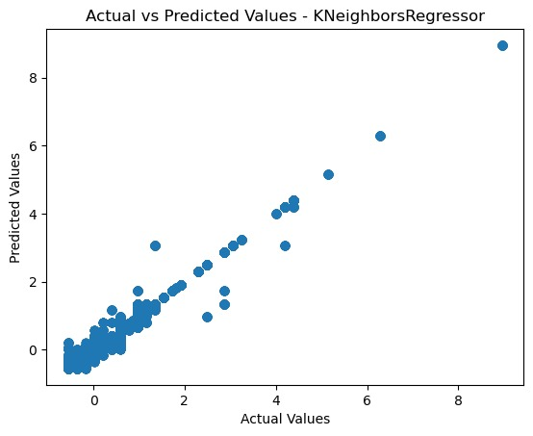

Graphical view ( Ex.)
Scatter plot Actual vs Predicted values for K-neighborsRegressor
Scatter plot Actual vs Predicted values for DecisionTreeRegressor

Slide 9

Conclusion
Successfully applied five machine learning algorithms for F1 dataset.
Trained the data and got high level of accuracy
DecisionTreeRegressor showed the best performance and CNN- LSTM showed the minimum level accuracy.
Future work could involve further optimization of these models, exploring alternative algorithms to extract more relevant information, different target value and evaluating the system on different datasets.

Slide 10
Reference
https://www.kaggle.com/datasets/rohanrao/formula-1-world-championship-1950-2020
https://scikit-learn.org/stable/modules/generated/sklearn.ensemble.RandomForestRegressor.html
https://machinelearningmastery.com/cnn-long-short-term-memory-networks/

Slide 11
Thank you

